Slide 1

FUNDAMENTALS OF BIG DATA ANALYTICS
FALL TERM1 – 2022
MATHEUS COSTA DE AGUIAR NEVES

Slide 2
PROJECT PROPOSAL
Nowadays, data analysis is increasingly being used in sports such as basketball, soccer, baseball, and among others. The use and collection of data in basketball is bringing major changes in the way teams hire players and also in the game strategy. Millions of dollars are invested in this sport every year and the team owners want to get it right to have a better result in the championships. The more wins a team has, the more attractive it becomes for possible sponsorships. In addition, fans will consume more products from the brand and will go to the stadium to watch games, generating even more revenue for the team. To minimize the mistakes of directors during the recruiting process and in the strategies used, data analysis is essential. We can analyze the game quality and performance of players, such as number of points per game, assists, rebounds, height, weight, age, and position to direct signings according to the needs of each team. Big data in sports can change the game in several ways, including helping players, coaches and other team members, promoting wins, and contributing to the success of the team.

Slide 3
PROBLEM
PROBLEM QUESTION:
According to the player's position, which variables have more value and should become a reference to maximize the probability of success in hiring new players?
BACKGROUND:
For this project, I will be using this dataset: https://www.kaggle.com/datasets/wyattowalsh/basketball with structured data. This dataset contains information from the first NBA season, 1946-47 to 2021-22. It contains general details from teams, such as name, city, founding date, stadium, drafts, players attributes (height, weight, age, salary) and also game statistics for each player (rebounds, points, assists, season experience, etc).

Slide 4
HYPOTHESIS
1- Does a team's payroll positively influence the percentage of wins?
2- The taller the player, the greater the chance of being chosen among the first in the draft?
3- Do taller players make more points and rebounds than shorter players?
4- Do shorter and lighter players give more assists and score more points?
5- Does a higher average team age negatively influence the percentage of wins?
6- Does a player's number of points, assists or rebounds positively influence his salary?

Slide 5
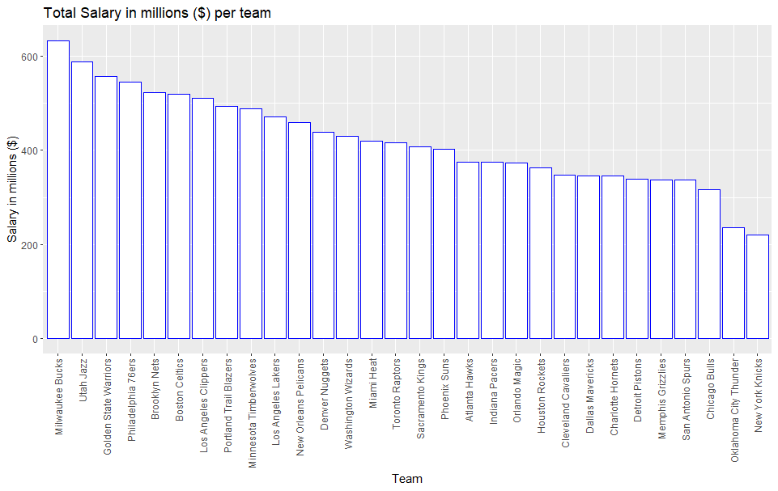
1- Does a team's payroll positively influence the percentage of wins?
Based on the graph, we can see that Bucks, Utah Jazz and Golden State Warriors were the teams that spent more with salary from the first season until now.

Slide 6
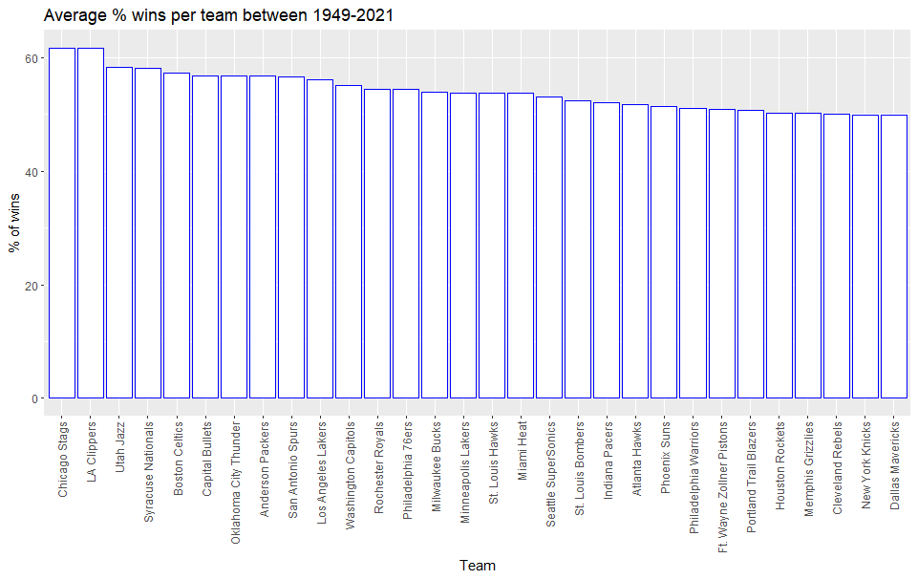
This graph shows the percentage of wins for each team. This was calculated with the number of wins since the first season divided by the number of games played. After analyzing the two graphs I can tell that there is no correlation between the amount spent in salaries and the percentage of wins. Top 5 teams for wins (home and away) were Chicago, Los Angeles Clippers, Utah Jazz, Syracuse Nationals and Boston Celtics. These teams are not the only ones who spent the most in salaries (besides of Utah Jazz, Boston Celtics and Los Angeles Clippers). The rest of the teams do not show the same correlation.

Slide 7
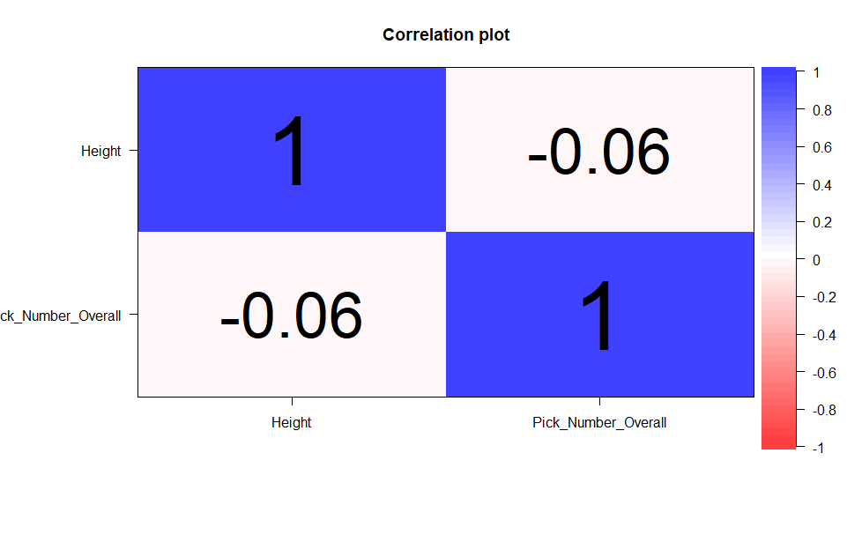
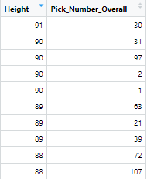
2- The taller the player, the greater the chance of being chosen among the first in the draft?
Based on the correlation plot we can see that there is no correlation between the height and the pick number in the draft. Also, if we look at the table, the tallest players were not the first ones to be picked. There are more variables that influences the chance of being chosen.

Slide 8
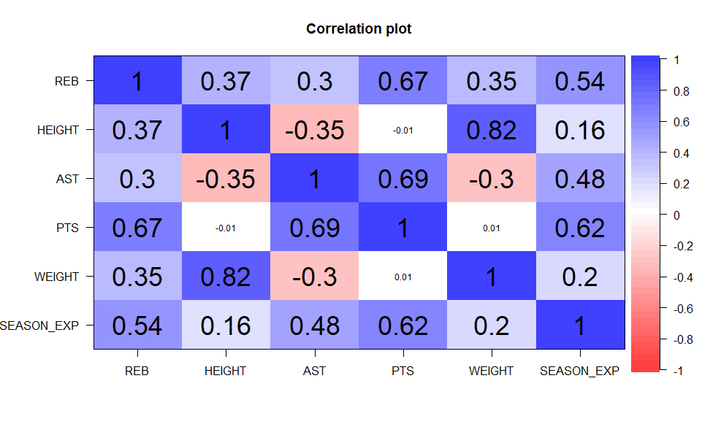
3- Do taller players make more points and rebounds?
So, the correlation between Rebounds and Height is 0.37, which is a positive number, but has a weak correlation. Height and Points does not show any correlation, but when looking at Rebounds and Points, we can see that players who make more rebounds have a bigger chance to score more points. The correlation between rebounds and Points is 0.67, which is a positive moderate correlation.

Slide 9
4- Shorter and lighter players give more assists and score more points?
Again, when we analyze the correlation plot we can see that Height and Assists has a weak, negative correlation, which is -0.35. This correlation shows that the taller the player is, the less assists he will make. Same when analyzing Weight and Assists. These variables have a weak, negative correlation, which is -0.30. This means that the lighter the player is, more assists he will make. Height and Weight do not show any correlation with Points scored.

Slide 10
5- Does a higher average team age negatively influence the percentage of wins?
Based on the correlation plot, there is a strong correlation between years of experience playing and number of points scored. It is 0.62, which is a positive moderate correlation. It means that the more years playing, the chance to score more points is higher. Thinking about it, the age will not influence negatively in the number of wins, because the more points you score, more chance you have to win the game. But, we have to check it using the age variable.

Slide 11
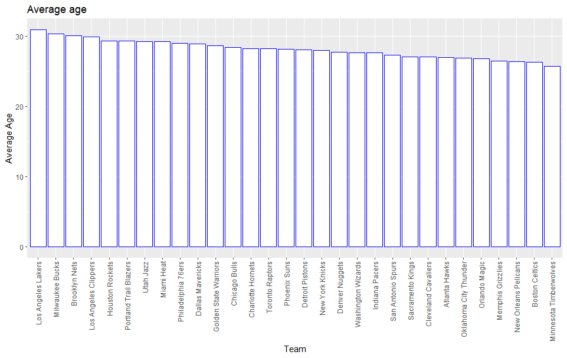
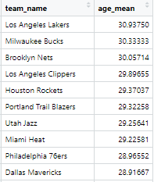
Using the last graph we manipulated to check the percentage of wins, the top 5 teams were: Chicago, Los Angeles Clippers, Utah Jazz, Syracuse Nationals and Boston Celtics. Based on this average age graph, we can see that Boston Celtics has one of the lowest average ages and they were ranked number 5 in number of wins. However, if you check the other teams, we can see that there is no correlation between these variables. This is a case to investigate deeper. On the table above there are the top 10 ranked teams based on their average age.

Slide 12
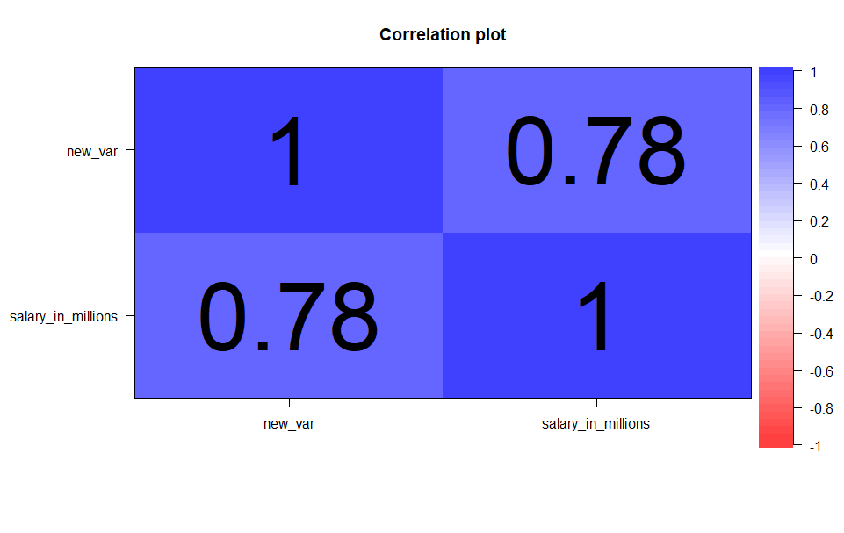
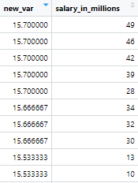
6- Does a player's number of points, assists or rebounds positively influence his salary?
For this analysis, I created a new variable where I divided the sum of assists, rebounds, and points by 3. I created that variable because the higher it is, the better the player is as well as the bigger probability of having a higher salary.
We can confirm that there is a strong positive correlation between the number of rebounds, assists and points and the salary of the player. The correlation is 0.78 and it makes sense because players with good statistics are the ones who performed the better.

Slide 13
According to the player's position, which variables have more value and should become a reference to maximize the probability of success in hiring new players?
Based on the findings and in the question above, I will analyze each position separately to see the correlation with the most important statistics and to build the models. Before analyzing all the positions, I will set a scale to decide if the player is good to hire or not. For that, I will consider the most important skills for each position based on their correlations and the distribution of the data. Also, in the models, other variables can be used, such as height, weight and number of years playing in NBA.

Slide 14
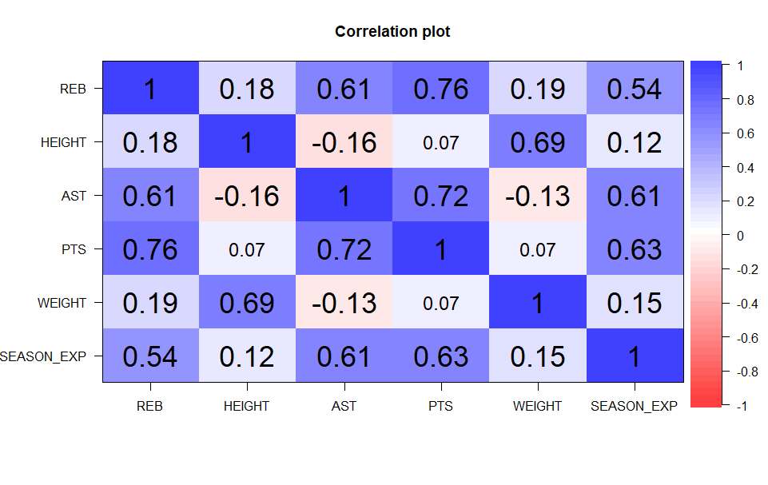
Guards
Guards are usually the best dribblers and passers of the team. They are also responsible for making the most assists and scoring many points. That’s why in the top 10 higher paying salaries, 7 of them are guards.
For the Guards, I will analyze Assists and Points as the most important variables and see the correlation with the others. So, to be a good Guard, based on the correlations, the player has to have good numbers in rebounds (as the correlation with assists and points are strong and positive, 0.76 and 0.61 accordingly). Also, the overall years of playing experience is an important variable as the correlation is also positive and relevant, 0.61 and 0.63. So, to hire a good guards, they need to have good numbers in points and assists, then good numbers in rebounds and lastly years of playing experience. Weight and Height do not show any correlation. Budget is also important variable, because as showed, the best guards have the highest salaries.

Slide 15
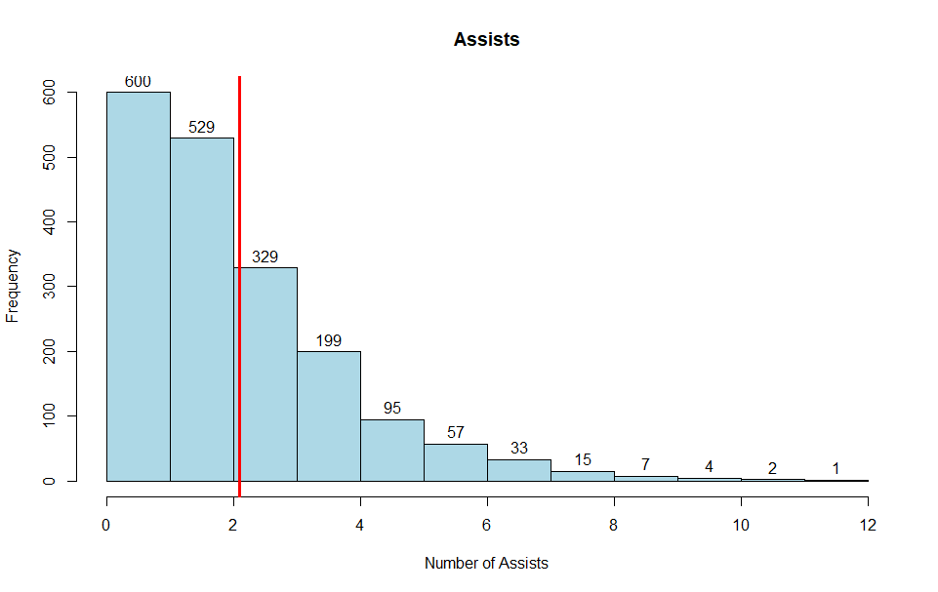
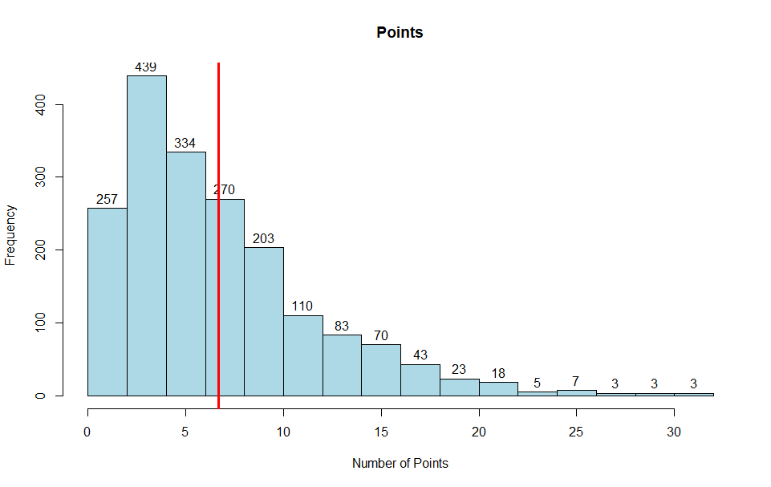
Model
Red line is the mean.
Points - 0 to 6 (Bad player) ; 6 to 10 (Common player) ; 10 to 15 (Good player) ; 15+ (Very Good player). Teams would hire players who have 10+ points.
Assists - 0 to 2 (Bad player) ; 2 to 4 (Common player) ; 4 to 6 (Good player) ; 6+ (Very Good player). Teams would hire players who have 4+ assists.

Slide 16
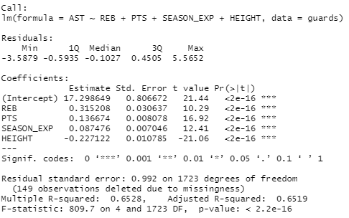
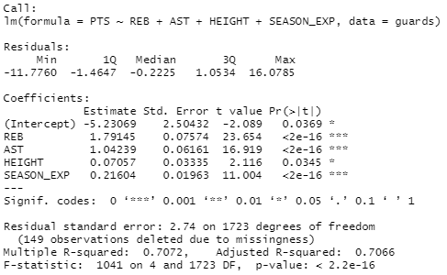
For tue guards, points will be analyzed as the most important variable and then assists.
Points Model
Assists Model
Above is the model for points. Weight was not used because it is not significant for the model. All the variables showed have a small p-value, which means they are statistically significant. R squared is 70.7%, which means that that the model explains 70.7% the variability of the response data around its mean. The model is significant. The equation would be:
Points = -5.2306 + 1.7914(rebounds) + 1.0423(assists) + 0.07057(height) + 0.2160(season_exp)
Above is the model for assists. Weight also was not used because it is not significant. The others variables showed have a small p-value, which means they are statistically significant. R squared is 65.3%, which means that that the model explains 65.3% the variability of the response data around its mean. The model is significant too. The equation would be:
Assists = 17.298 + 0.3152(rebounds) + 0.1366(points) + 0.0874(season_exp) - 0.2271(height)

Slide 17
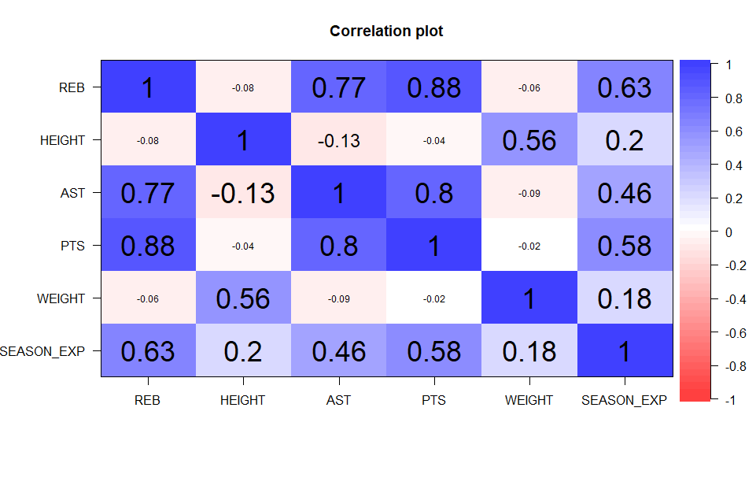
Centers
Centers are usually the tallest players in the team and they are responsible for scoring points and rebounds as they play near the basket.
For the Centers, I will analyze Rebounds and Points as the most important variables. The correlation shows that Rebounds and Points are highly correlated, 0.88, and it states that these two variables are the most common when looking at Centers. After these two, we can see that years of playing experience have a moderate influence in rebounds and points scored, 0.63 and 0.58. Also, the graph shows that a good center is also good at assisting other players. The correlation between these two variables is 0.77. Lastly, the average height is 8’2”. So, after analyzing rebounds and points, we can determine that a good center needs years of playing experience and a high number of assists.

Slide 18
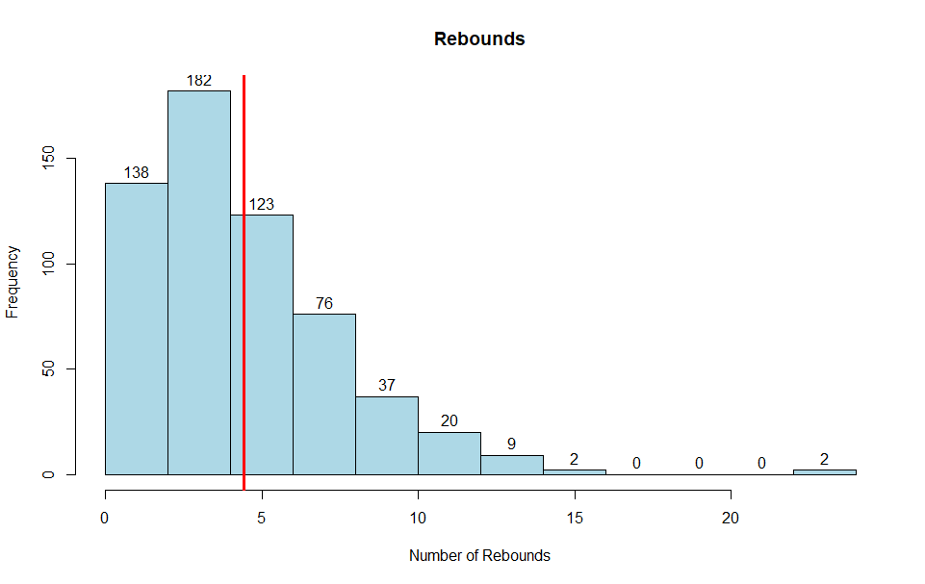
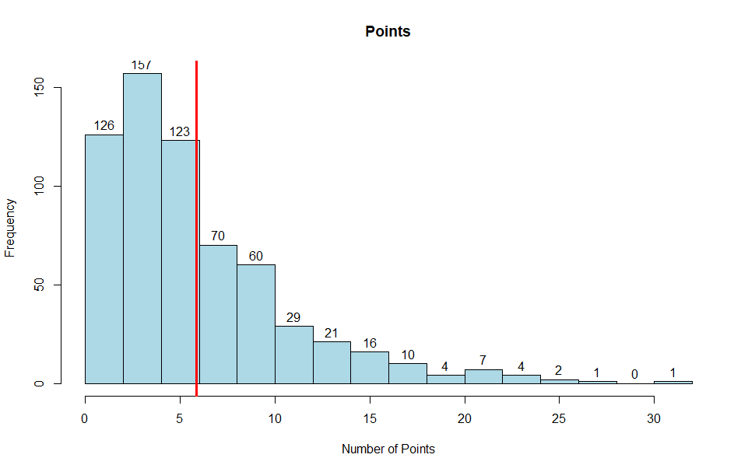
Model
Red line is the mean.
Points - 0 to 6 (Bad player) ; 6 to 11 (Common player) ; 11 to 15 (Good player) ; 15+ (Very Good player). Teams would hire players who have 11+ points.
Rebounds - 0 to 4 (Bad player) ; 4 to 6 (Common player) ; 6 to 9 (Good player) ; 9+ (Very Good player). Teams would hire players who have 6+ assists.

Slide 19
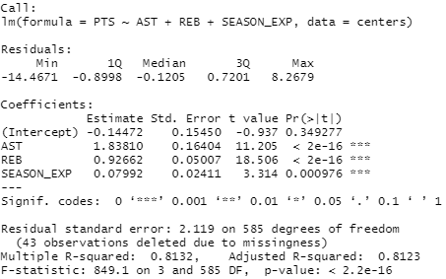
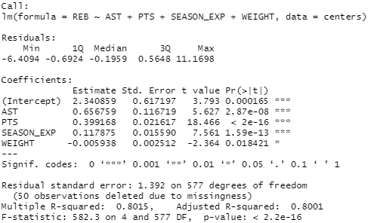
For the centers, points will be analyzed as the most important variable and then rebounds.
Points Model
Rebounds Model
Above is the model for points. Weight and Height were not used because they are not statistically significant for the model. All the variables showed have a small p-value, which means they are statistically significant. R squared is 81.3%, which means that that the model explains 81.3% the variability of the response data around its mean. The model is significant. The equation would be:
Points = -0.1447 + 1.838(assists) + 0.9266(rebounds) + 0.0799(season_exp)
Above is the model for rebounds. Height also was not used because it is not significant. The others variables showed have a small p-value, which means they are statistically significant. This model have a very high R squared, 80.15%The model is significant too. The equation would be:
Rebounds = 2.3408 + 0.6567(assists) + 0.3991(points) + 0.1178(season_exp) - 0.0059(weight)

Slide 20
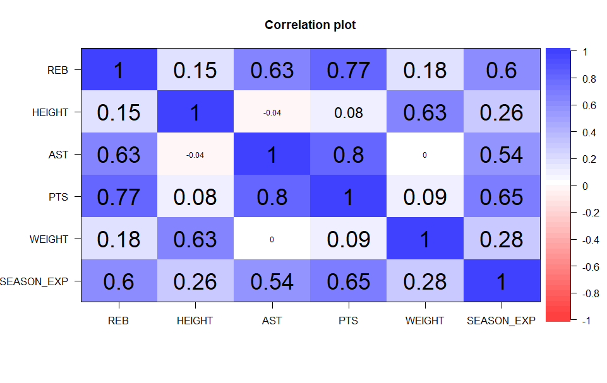
Forwards
Forwards usually play offensively, but when defending, their most important task is to focus on the Rebounds.
For the Forwards, I will analyze Rebounds and Points to analyze as the most important variables. Again, years of playing experience have an important correlation with rebounds, 0.60, and points, 0.65. Another important correlation is in assists with rebounds, 0.63, and with points 0.77. Height is also important for these players because they are responsible for rebounds. The average height is 7’5’’. After analyzing the graph, I can say that to hire a good forward, besides of good numbers in rebounds and points, he has to have a good number in assists and years of playing experience as well.

Slide 21
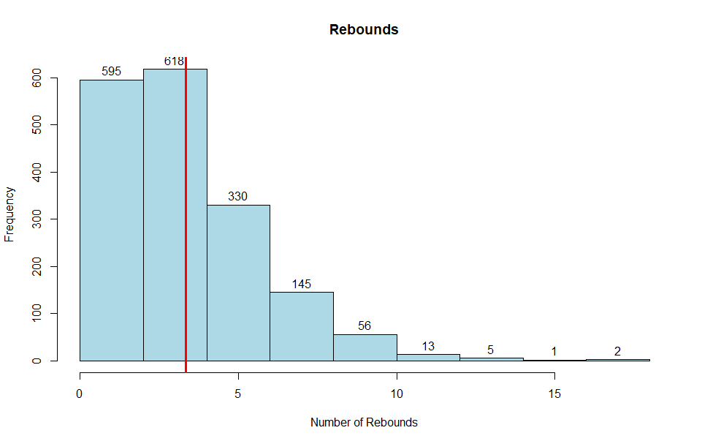
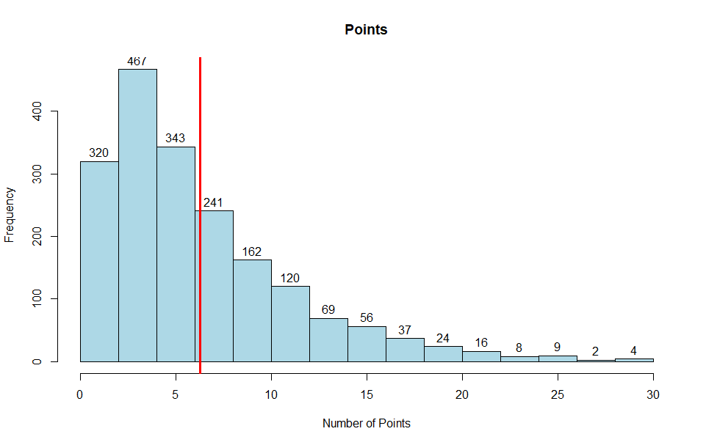
Model
Red line is the mean.
Points - 0 to 6 (Bad player) ; 6 to 10 (Common player) ; 10 to 15 (Good player) ; 15+ (Very Good player). Teams would hire players who have 10+ points.
Rebounds - 0 to 3.5 (Bad player) ; 3.5 to 5 (Common player) ; 5 to 8 (Good player) ; 8+ (Very Good player). Teams would hire players who have 5+ assists.

Slide 22
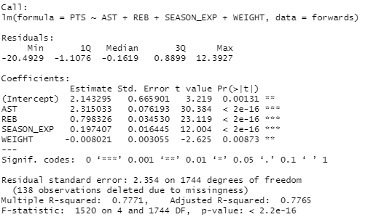
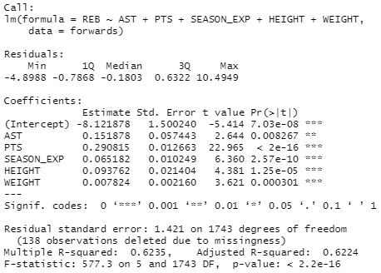
For the forwards, points will be analyzed as the most important variable and then rebounds.
Points Model
Rebounds Model
Above is the model for points. Height was not used because it is not significant for the model. The other variables were used because they have a small p-value, which means they are statistically significant. R squared is 77.7%%, which is a very high value. The model is significant. The equation would be:
Points = 2.1432 + 2.315(assists) + 0.7983(rebounds) + 0.1974(season_exp) – 0.008(weight)
Above is the model for rebounds. All the variables were used because they have a small p-value, which means they are statistically significant. R squared is 62.3%, which means that that the model explains 62.3% the variability of the response data around its mean. The model is significant. The equation would be:
Rebounds = -8.1218 + 0.1518(assists) + 0.290(points) + 0.0651(season_exp) + 0.0937(height) + 0.0078(weight)

Slide 23
After analyzing all the data, graphs and models, I can tell that years of playing experience is very important to hire good basketball players, no matter the position. The variables chosen for each position were based on the history of basketball and the roles that each player has on the court. This study can be improved if there is more data available, such as the number of blocks per season or the number of minutes played per season, for example. Not to mention that a year-by-year analysis can be very helpful to see the difference over time. Just as everything evolves, the sport also evolves. Basketball played today is not the same as played in the first NBA season in 1949. So that the models can help in decision making, the variables must be evaluated in order. For example, for guards, first analyze the number of points model and if it reaches the expected value, analyze the assists model.

Slide 24
Practical example
Suppose a team wants to hire a new guard with the following stats:
Points – 17.0 ; Assists – 6.5 ; Rebounds – 3.0 ; Seasons of experience – 8 ;Height – 79 ; Weight – 189
Should the team hire this player or not?
Based on the models, first we analyze the model for points:
Points = -5.2306 + 1.7914(rebounds) + 1.0423(assists) + 0.07057(height) + 0.2160(season_exp), using the new data, the number of points will be, -5.2306 + 1.7914(3.0) + 1.0423(6.5) + 0.07057(79) + 0.2160(8), equals to 14.2366, which means based on the scale the player is a GOOD PLAYER, greater than 10, teams would hire.
Now we can analyze the model for assists.
Assists = 17.298 + 0.3152(rebounds) + 0.1366(points) + 0.0874(season_exp) - 0.2271(height), using the new data, it will be, 17.298 + 0.3152(3.0) + 0.1366(17.0) + 0.0874(8) - 0.2271(79), equals to 3.325, which means the player a COMMON PLAYER. Teams would hire if the assists are greater than 4.
This player is not a good choice.

Slide 25
THANK YOU!

